Slide 1
CSE 477: Introduction to Computer Security
Lecture – 1
Course Teacher: Dr. Md Sadek Ferdous
Assistant Professor, CSE, SUST
E-mail: ripul.bd@gmail.com

Slide 2
Outline
Motivations
Course Information
Basic concepts

Slide 3
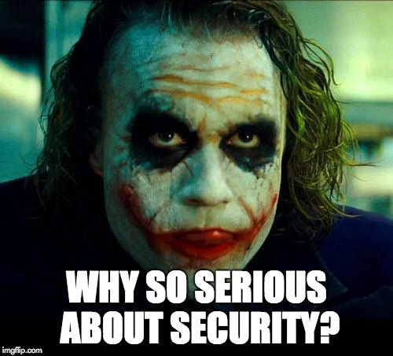
Outline
Motivations
Course Information
Basic concepts
Security properties
Security attacks
Security failure & secure solutions

Slide 4
Motivations
Currently around 4.77 billions of mobiles and increasing
Around 4 billions of Internet users
Around 320 millions of domain names
Around $2300 billions of retail e-commerce sales and growing
Almost all spheres of our lives are somehow dependent on the Internet and different web services
Mostly in developed countries, developing nations are catching up
This trend will continue to grow

Slide 5
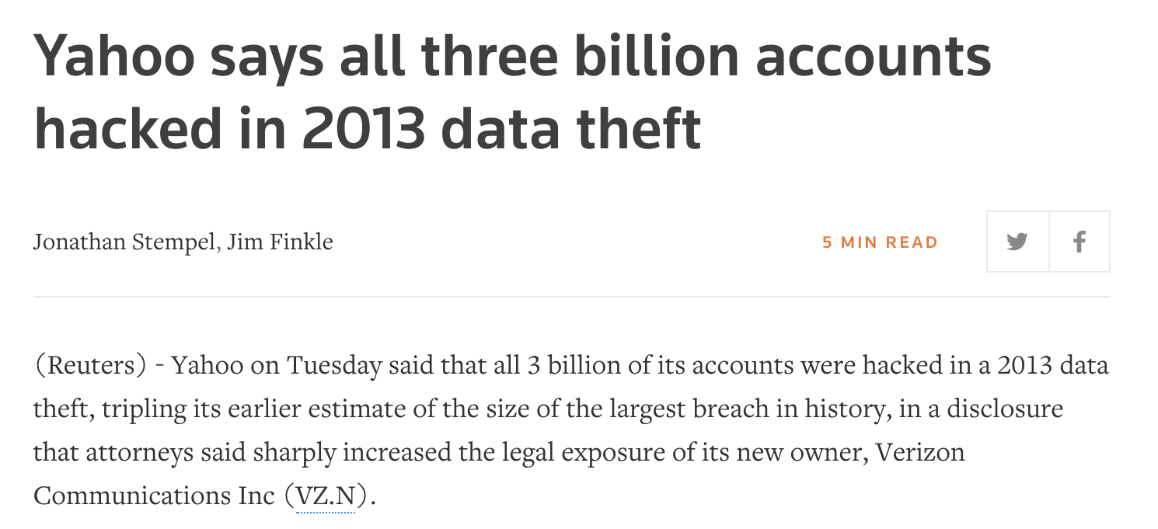
Motivations

Slide 6
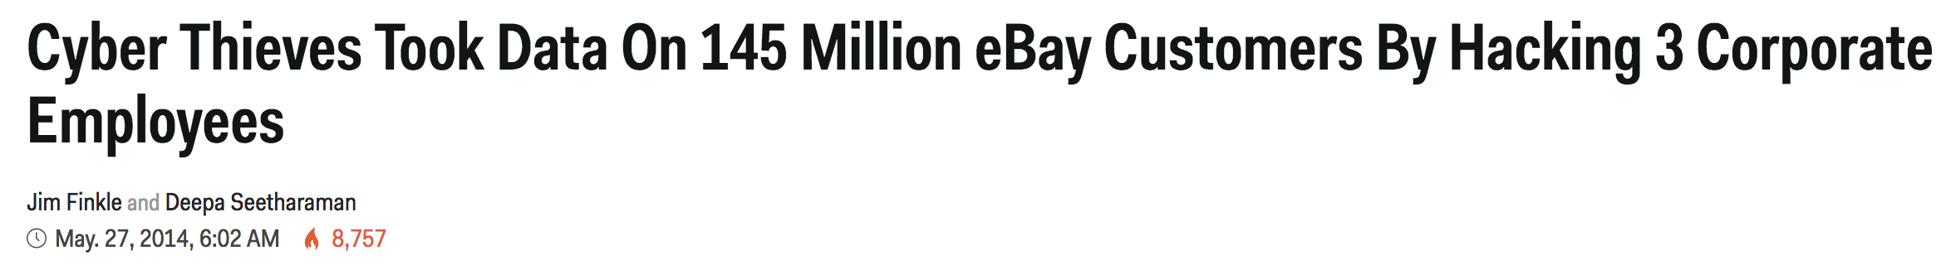
Motivations

Slide 7
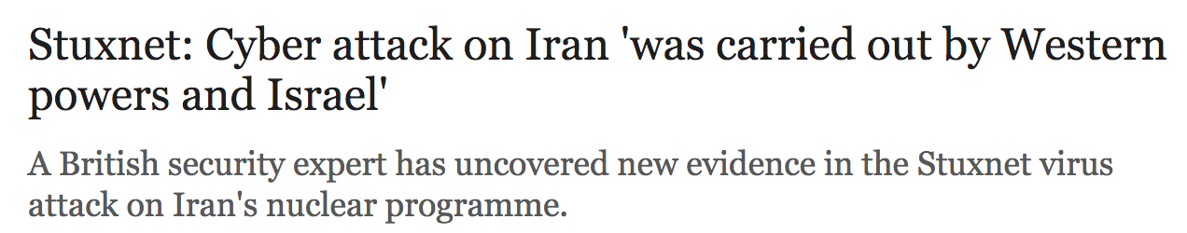
Motivations

Slide 8
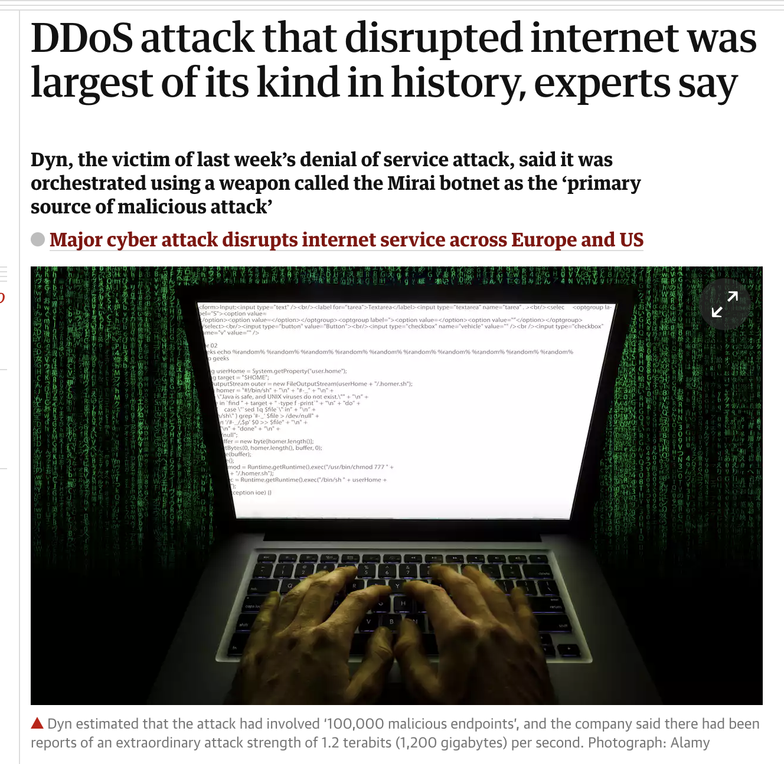
Motivations

Slide 9
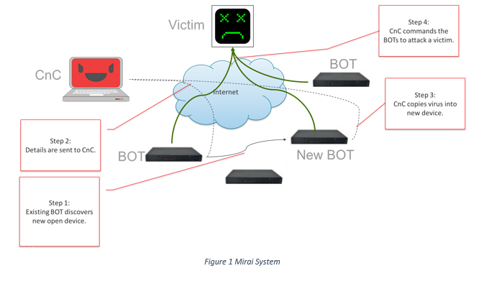
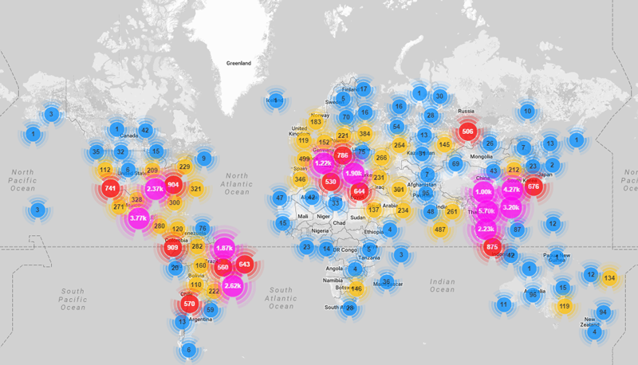
Motivations
Mirai Botnet
https://www.corero.com/img/Diagrams/mirai-botnet-ddos-attack.jpg
https://www.incapsula.com/blog/wp-content/uploads/2016/10/mirai-botnet-map.png

Slide 10
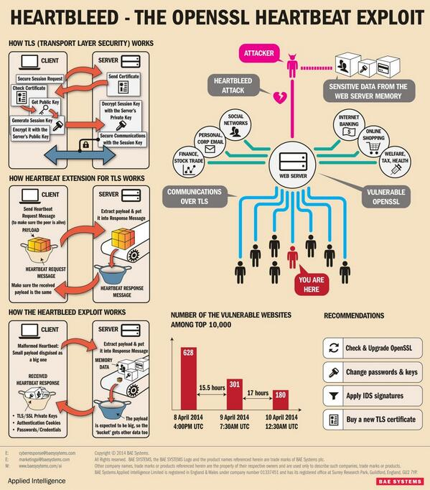
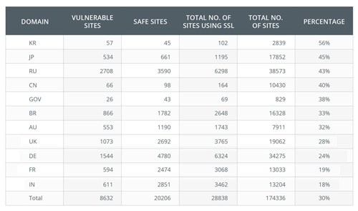
Motivations
Source: https://storify.com/services/proxy/2/WJZ_9tf1AVAiKovh33lUA/http/pbs.twimg.com/media/Bk7vrLqIgAArRrS.jpg
Source: https://i1.wp.com/securityaffairs.co/wordpress/wp-content/uploads/2014/04/heartbleed-SSL-scan-results.jpg

Slide 11
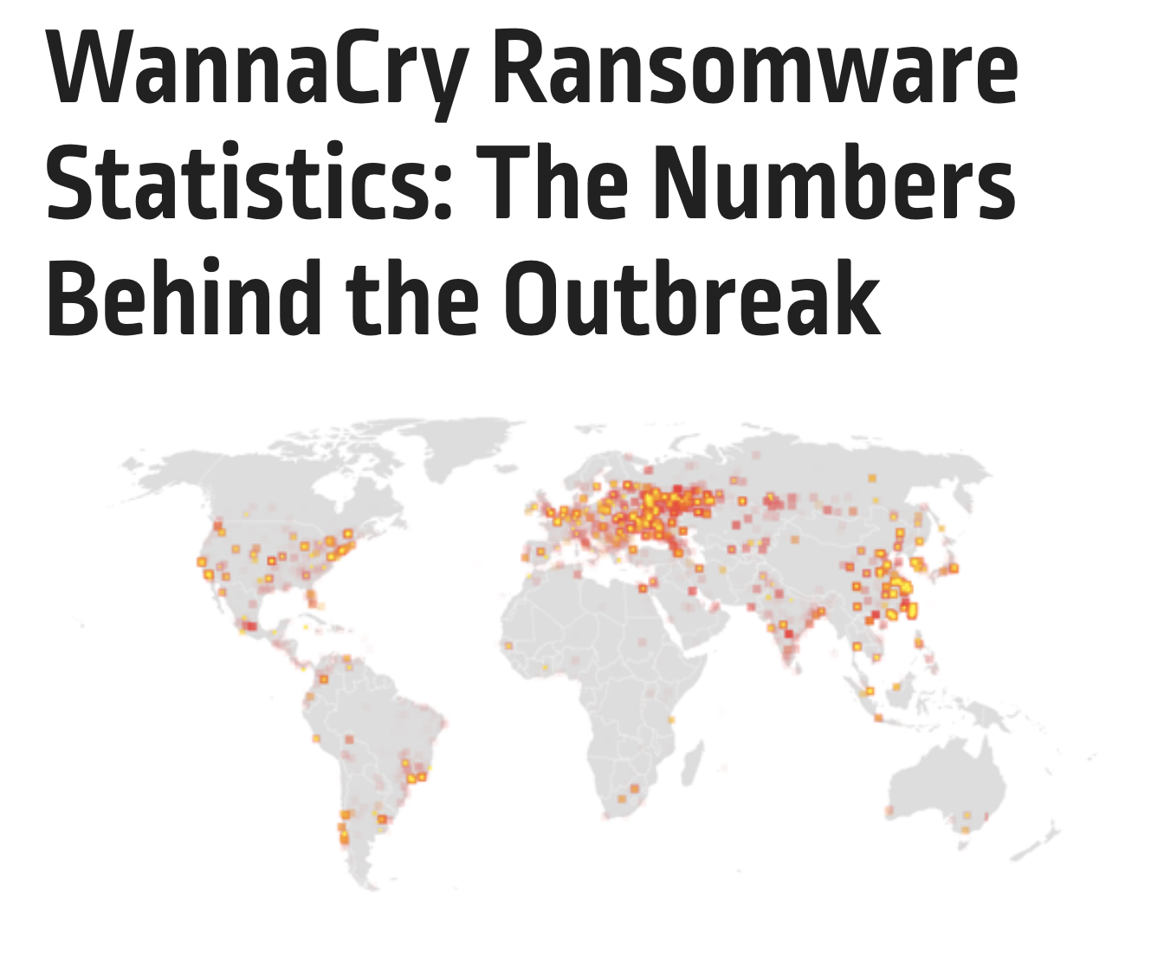
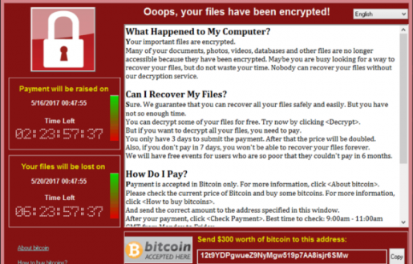

Motivations
Source: http://www.asuamaytinh.com/wp-content/uploads/2017/05/virus-wanna-cry-la-gi-cach-phong-chong-ra-sao-1888-660x330.jpg

Slide 12
Historical timeline - 1
Source: http://www.inf.ed.ac.uk/teaching/courses/cs/0910/lecs/intro.pdf

Slide 13
Historical timeline - 2
Source: http://www.inf.ed.ac.uk/teaching/courses/cs/0910/lecs/intro.pdf

Slide 14
Historical timeline - 3
Source: http://www.inf.ed.ac.uk/teaching/courses/cs/0910/lecs/intro.pdf

Slide 15
Historical timeline - 4
Source: http://www.inf.ed.ac.uk/teaching/courses/cs/0910/lecs/intro.pdf

Slide 16

Outline
Motivations
Course Information
Basic concepts
Security properties
Security attacks
Security failure & secure solutions

Slide 17
What is computer security?
Computer security is the protection of computer systems
operating in adversarial environments
with possible adversaries
Protection aims to:
allow intended use
prevent unintended use

Slide 18
What is computer security?
Confidentiality
Integrity
Availability
Authenticity
Anonymity
….
tries to break in
having security properties
Personal motivation (Ex spouse/employee)
Financial motivation
Political motivation
In this course
why systems are insecure?
how to make them secure?

Slide 19


Course Information
Security
Information
Web
Network
Physical Security
Device Security
Source: https://d2gg9evh47fn9z.cloudfront.net/800px_COLOURBOX18770823.jpg
Source: http://itak.iaitam.org/wp-content/uploads/sites/2/2015/06/Can-Mega-Data-Breaches-be-Prevented-%E2%80%93-What-ITAM-Can-Learn-from-Target-and-Home-Depot.jpg

Slide 20

Course Information
Brief introduction to Computer Security
Physical Security
Operating System Security
Basic crypto & Security Protocols
Internet and network security
Web and email security
Malware
Bitcoin (if time permits)
Will not cover
Deep mathematical study of modern cryptography
However, basic cryptography will be covered

Slide 21
Assessment (tentative)
Class Attendance: 10%
Homework + Assignment: 5%
Term Test: 15%
Final exam: 70%

Slide 22
Resources
Textbook
Introduction to Computer Security - Michael Goodrich & Roberto Tamassia, First Edition
Additional Resources:
Introduction to Computer Security – Matt Bishop
Handbook of Applied Cryptography - Alfred J. Menezes, Paul C. van Oorschot and Scott A. Vanstone. http://cacr.uwaterloo.ca/hac/
Additional research papers will be supplied throughout the course

Slide 23
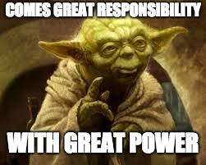
Advisory: Ethical code of conduct
With great power comes great responsibility!
Course materials and knowledge gained in this course should not be considered as an incitement to crack!
Breaking into system to demonstrate security problems might cause irreversible damages to many innocent users and might lead to prosecution!
If you spot a security hole in a running system, don’t exploit it, instead consider contacting the relevant administrators confidentially
Sysadmins might not act quickly as it is difficult to keep up with latest security patches
Especially true in the university setting:
traditional approach: open access above security,
resources for sysadmin are very tight

Slide 24
Advisory: Ethical code of conduct
If you want to experiment with security holes, play with your own machine, in your own private network of machines.
e.g. using a form of virtualisation: e.g., VMWare, Virtual Box, etc.
If you discover a new security hole in a standard and popular application, or operating system
consider contacting the vendor of the software/OS in the first case
consider suggesting a fix, if you can
You might also raise the issue in a security forum for discussion
without providing complete details of the hole
The software vendor or other security experts will be able to confirm or deny, and work can begin on fixing the problem

Slide 25
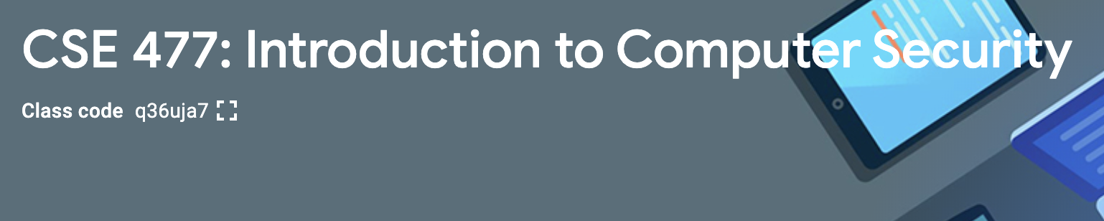
Google classroom code

